Slide 1
Credit Booms Gone Bust: Monetary Policy, Leverage Cycles and Financial Crises
By Moritz Schularick and Alan M. Taylor
presentation given by Yimeng Xie

Slide 2
Outline
This paper studies the behavior of money, credit, and macroeconomic indicators based on historical dataset for 14 countries over the years 1870-2008.
Prior-WW2 period
credit
money
Post-WW2 period
credit
money
Notes:
Indeed the contribution of this paper is that it uses long-run comparative data which makes things clearer.

Slide 3
Literature Survey
1. “Money view” by Friedman and Schwartz (1963)
2. “Irrelevance view” by Modigliani and Miller (1958)
3. “Credit view” by Fisher (1933), Gurley and Shaw (1955), Mishkin (1978), Bernanke (1983) and Gertler(1988)
Notes:
Indeed the contribution of this paper is that it uses long-run comparative data which makes things clearer.

Slide 4
Literature Survey
Rousseau and Wachtel (1998) investigate the link between economic performance and financial intermediation between 1870 and 1929 for five industrial countries.
Eichengreen and Mitchener (2003) study the credit boom preceding the Great Depression.
Adrian and Shin (2008,2009), Mendoza and Terrones (2008), Hume and Sentance (2009) analyze the structural changes in the financial system and the consequences for financial stability and monetary policy.
Notes:
Some similar work of this paper is presented here.

Slide 5
The main three questions needed to solve
(i) which key stylized facts can we derive from the long-run trends in money and credit aggregates?
(ii) how have the monetary policy responses to financial crises changed over time?
(iii) what role do credit and money play as a cause of financial crises?
Notes:
With these facts, the paper try to solve three questions.

Slide 6
The main three questions needed to solve
(i) which key stylized facts can we derive from the long-run trends in money and credit aggregates?
(ii) how have the monetary policy responses to financial crises changed over time?
(iii) what role do credit and money play as a cause of financial crises?

Slide 7
Data
The countries covered are the United States, Canada, Australia, Denmark, France, Germany, Italy, Japan, the Netherland, Norway, Spain, Sweden and the United Kingdom.
Data are yearly for aggregate bank loans and total balance sheet size of the banking sector, narrow and broad monetary aggregates as well as nominal and real output, inflation and investment.

Slide 8
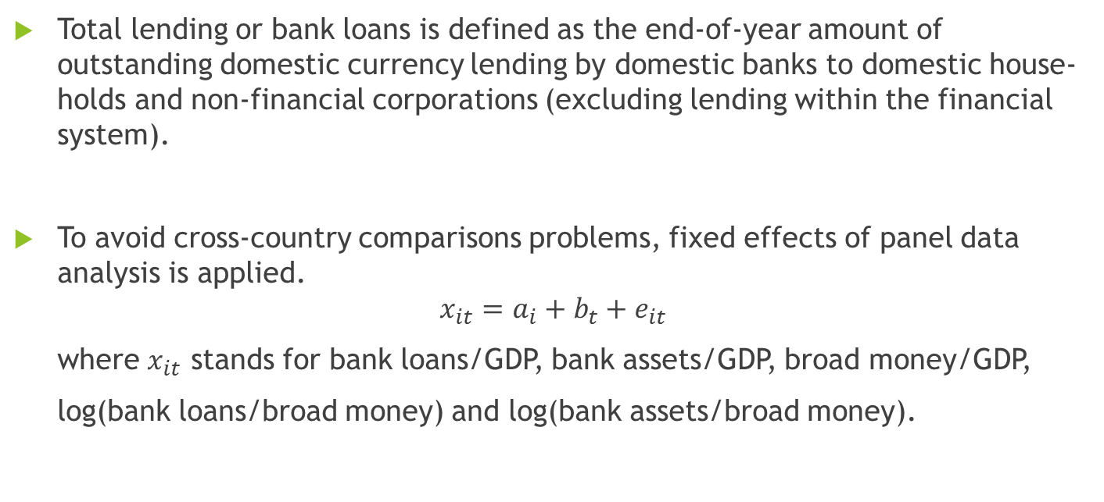
Data
Total lending or bank loans is defined as the end-of-year amount of outstanding domestic currency lending by domestic banks to domestic house-holds and non-financial corporations (excluding lending within the financial system).
To avoid cross-country comparisons problems, fixed effects of panel data analysis is applied.
$$x_{it}=a_{i}+b_{t}+e_{it}$$
where $x_{it}$ stands for bank loans/GDP, bank assets/GDP, broad money/GDP,
log(bank loans/broad money) and log(bank assets/broad money).
Notes:
Impress we are interesting in b_t, and later the time series graphs of b_t are drawn.

Slide 9
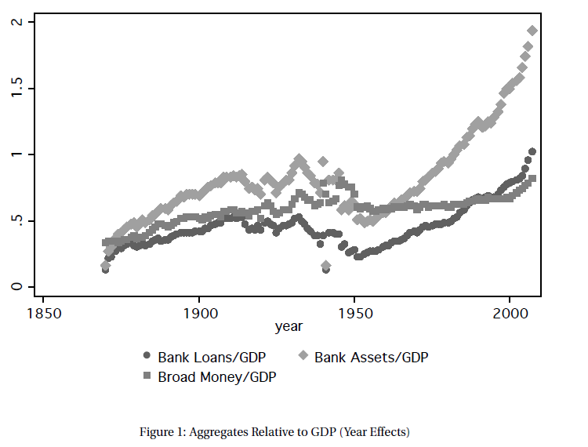
Notes:
The figure is

Slide 10
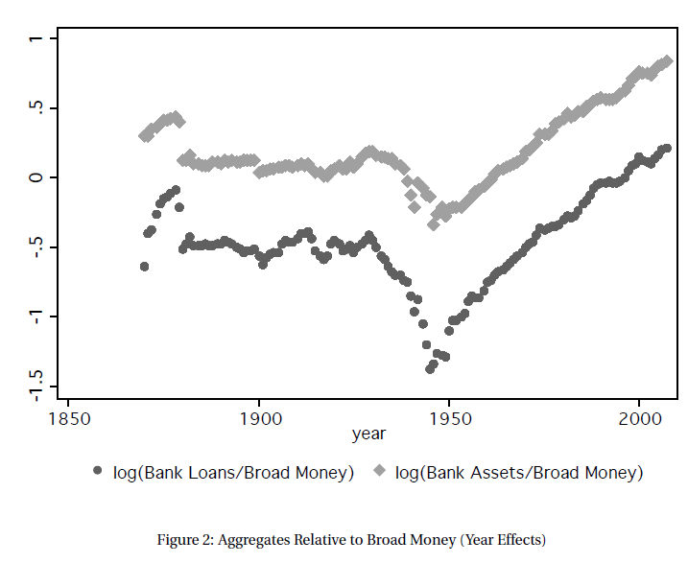

Slide 11
Data
The first era: 1870-1939; in the long run, money and credit maintained a roughly stable relationship to each other, and to the size of the economy measured by GDP. The only exception is great depression. And in this period, money view is able to dominate.
The second era: post-1945, money and credit recover and the latter decouples from the former while both grow rapidly. That is because of the increased leverage and augmented funding via the nonmonetary liabilities of banks.

Slide 12
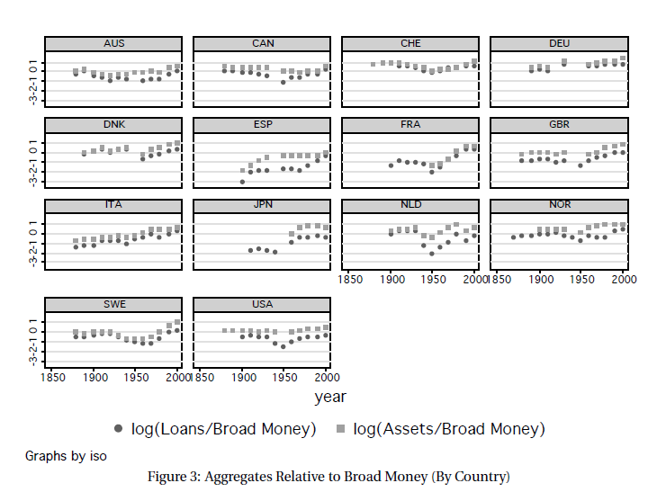

Slide 13
Event Analysis
Financial crises are defined as events during which a country’s banking sector experiences bank runs, sharp increases in default rates accompanied by large losses of capital that result in public intervention.
An annual coding of financial crisis episodes based on documentary descriptions in Bordo et al. (2001) and Reinhart and Rogoff (2009) is adopted, both of which are widely-used historical data sets that we compared and merged for a consistent definition of event windows
Notes:
Some similar work of this paper is presented here.

Slide 14
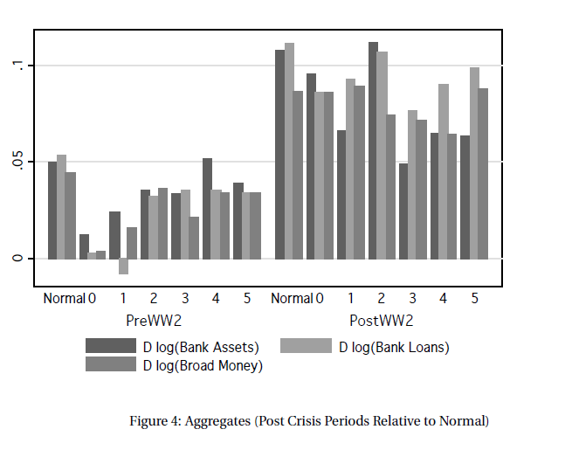
Notes:
Some similar work of this paper is presented here.

Slide 15
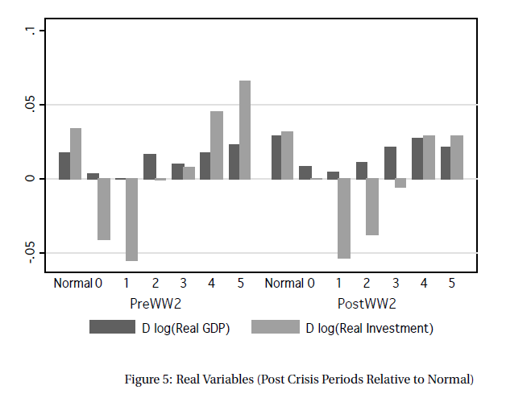
Notes:
Some similar work of this paper is presented here.

Slide 16
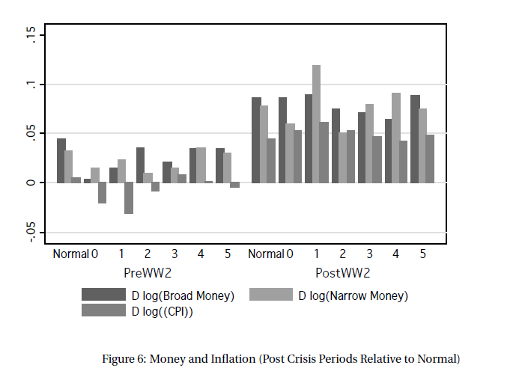
Notes:
Some similar work of this paper is presented here.

Slide 17
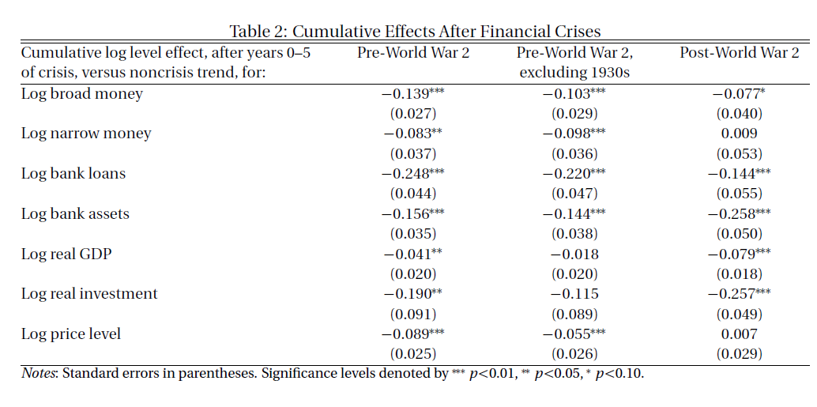
Notes:
Some similar work of this paper is presented here.

Slide 18
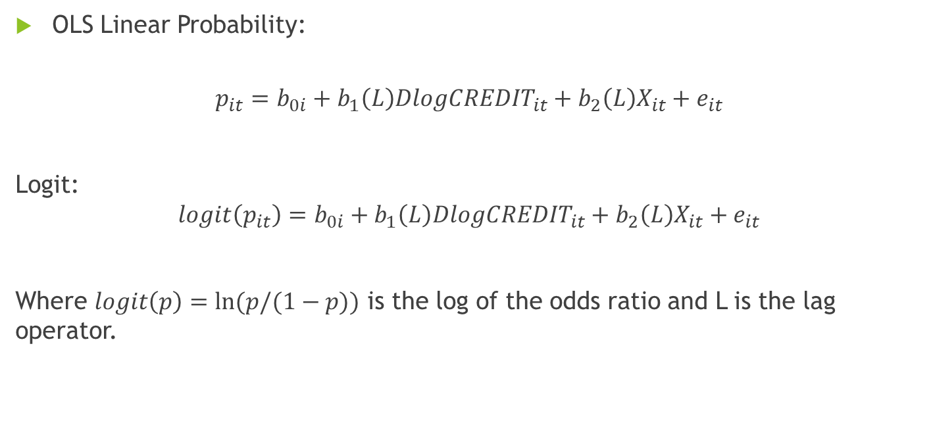
Does a country’s recent history of credit growth help predict a financial crisis?
OLS Linear Probability:
$$p_{it}=b_{0i}+b_{1}\left(L\right)Dlog{CREDIT}_{it}+b_{2}\left(L\right)X_{it}+e_{it}$$
Logit:
$$logit\left(p_{it}\right)=b_{0i}+b_{1}\left(L\right)Dlog{CREDIT}_{it}+b_{2}\left(L\right)X_{it}+e_{it}$$
Where $logit\left(p\right)=ln⁡(p/(1−p))$ is the log of the odds ratio and L is the lag operator.
Notes:
So a practical application of this is to use the credit to predict the financial crisis. So the paper introduces these models. Here and p is the dummy variable that if there is a financial crisis, it is equal to 1. X is the control variables we might need in some specifications. There are two models: OLS linear probability and logit models.

Slide 19
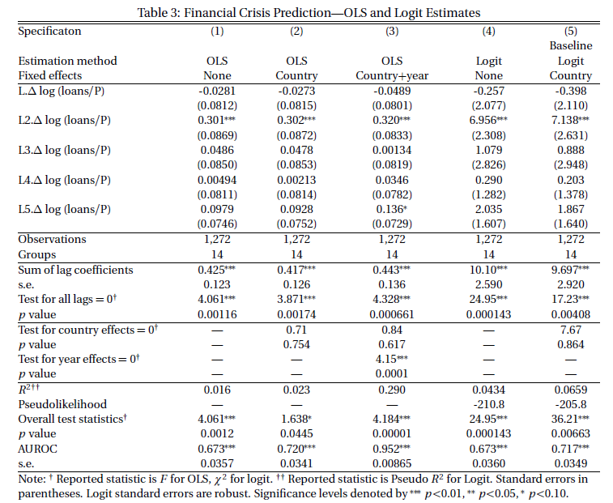
Notes:
Table 3 gives the baseline results of OLS and LOGIT estimates. The two lags of credit keeps significant for all cases, but R-squared is highest in specification (5). This marks the good performance of fit power. Another indicator the paper is interested in is AUROC, which is actually computed by Receiver Operating Characteristic Curve. The value is shown in the table, and still we can find specification (5) has a relatively high value.

Slide 20
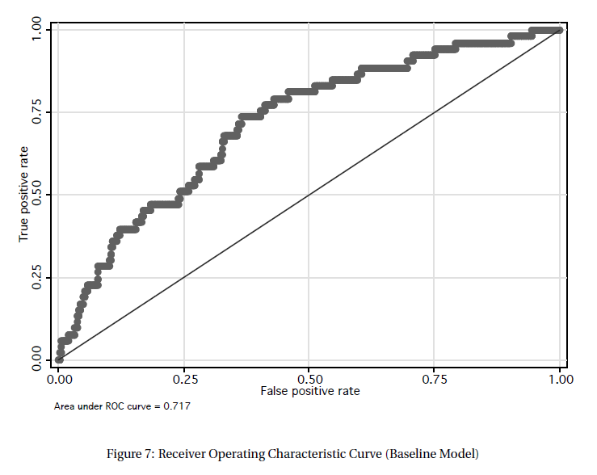

Slide 21
Question a
Which is better to predict financial crisis, aggregate credit or aggregate money? Can the two variables be substitution for each other?

Slide 22
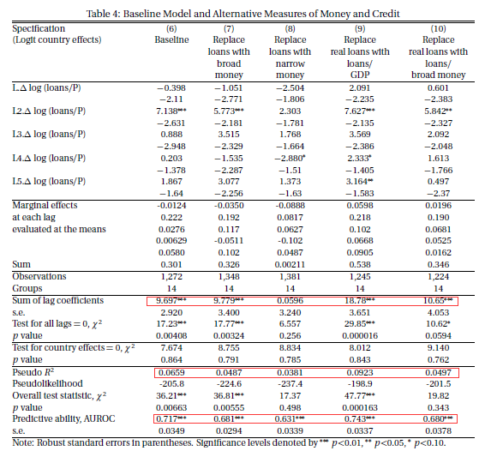

Slide 23
Question b
Is it always the case that credit is better than money in prediction of crisis? Or is it just true in the post-WW2 period?
Prior-WW2 period
credit
money
Post-WW2 period
credit
money
Notes:
Is it always the case that credit is better than money in prediction of crisis? Or it is just true in the post-WW2 period?

Slide 24
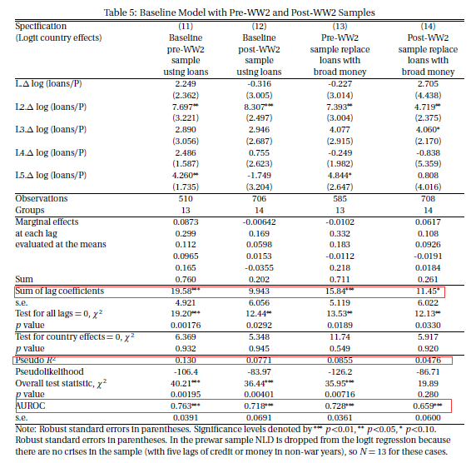

Slide 25
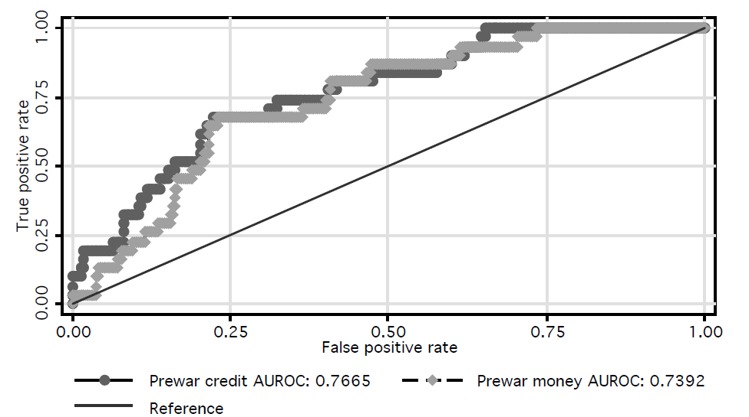
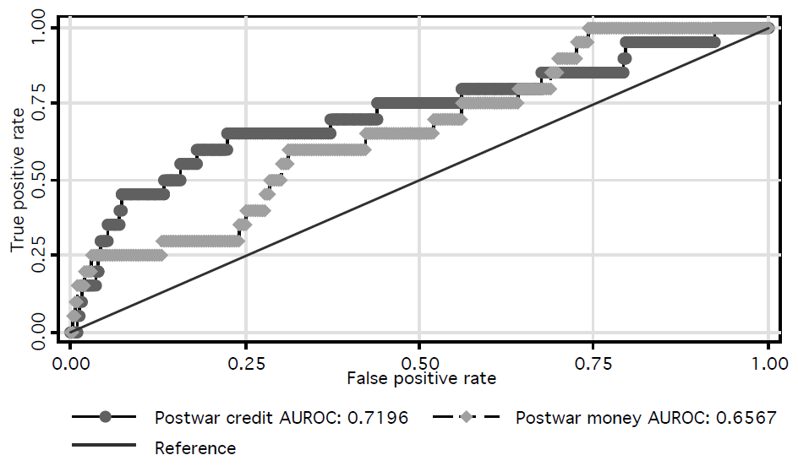
Notes:
These figures show in different periods, what are the performances of credit and money models. In the pre-WW2 period, the two models’ AUROCs are almost the same, while in the post-WW2 period, the two curves are significantly different, with credit model exceeding money model in most cases. And Kolmogorov-Smirnov test indicates the predictive power of money model is not statistically different from zero.

Slide 26
Robust test
What if we add macroeconomic variables into the model? Would the power of credit be declined?

Slide 27
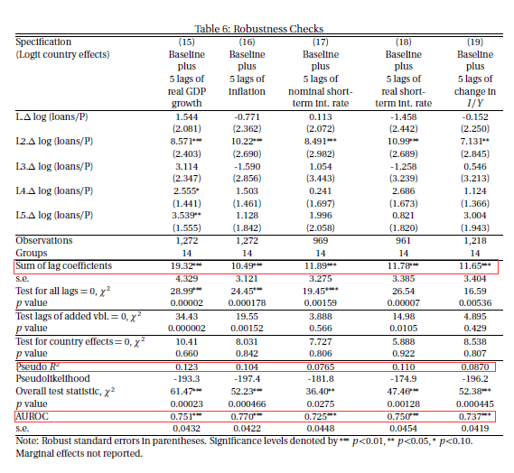
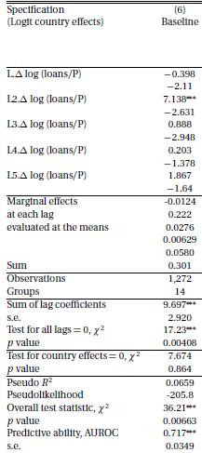
Notes:
In table six omitted variables issues are checked. The error term of specification (6) may include some other variables that need to be necessarily counted in the model. So in specification (15)-(19), GDP growth, inflation, nominal short term interest rate, real short term interest rate and changes in I/Y are respectively added to the baseline model. It suggests that adding those variables, the influence of credit becomes even bigger as the sum of lag coefficients has larger value than baseline model.

Slide 28
What if asset price and financial system development are taken into account to predict financial crisis?
Are asset price booms more dangerous when they occur at high credit to GDP levels or when they coincide with elevated rates of credit growth in the economy?

Slide 29
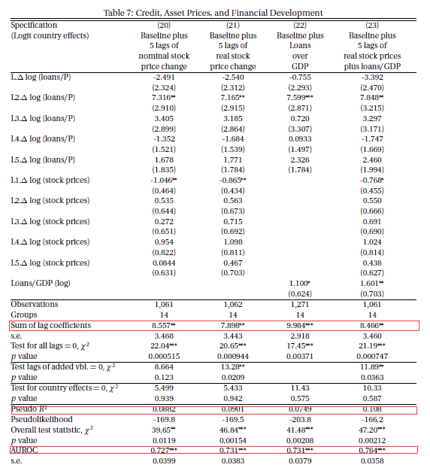
Notes:
Table 7 accounts for asset prices’ influence. Common views attribute the asset price booms as the main factor to financial crisis. In table 7, credit is compared with asset prices which is represented by stock price changes in specification 20 and 21. While specification 22 displays the results where loans over GDP is added, which stands for how big the financial system is.

Slide 30
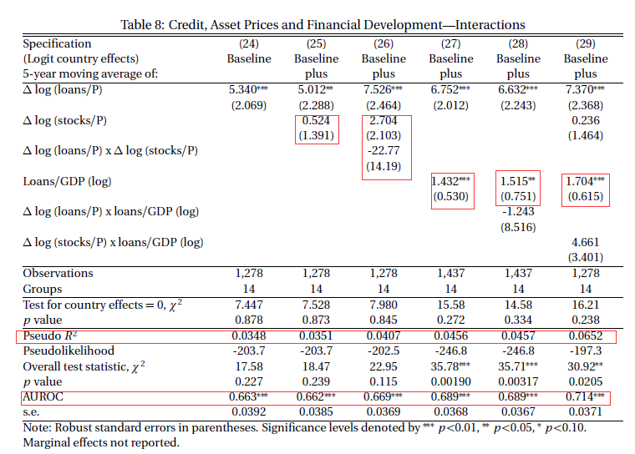
Notes:
Table 8 compares explores the interaction between credit, asset prices and financial system.

Slide 31
Conclusions
1. The leverage in the financial sector has increased generally in the second half of the twentieth century.
2. Monetary policy responses to financial crisis have been more aggressive in post-1945 period.
3. Credit growth is a powerful predictor of financial crises, suggesting financial crisis is indeed credit booms gone wrong.
Notes:
Some similar work of this paper is presented here.

Slide 32
My comment
1. Credit has now become an important indicator for banks in case there is possibility of crisis, and regulations such as Basel III have been more strict in controlling credit of banks.
2. However, this paper has focused on mainly developed countries, which have strong fundamentals. Yet for many developing countries, more factors should be accounted for financial crisis. For example, capital inflow is believed as the main force to raise Southeastern Asian crisis in 1997.
3. Still how long the crisis lasts is a big question, which this paper solves by borrowing findings from other literatures.
Notes:
Some similar work of this paper is presented here.

